Slide 1

Little Cigar and Cigarillo Product Appeal and Use
Among Racially/Ethnically Diverse Young Adults
Kymberle Landrum Sterling, DrPH
University of Texas School of Public Health
Notes:
Today we will focus on little filtered cigars and cigarillos. These products are two of the three major classes of cigar products sold in the United States and are most commonly used.
For rest of the talk, we’ll describe how discrete choice experimental methods have ben used to understand product appeal among a diverse samples of young adults.

Slide 2
Disclosures
Research presented in this study is funded by:
National Institute of Drug Abuse, Food and Drug Administration: 1P50DA036128-01
National Cancer Institute, Food and Drug Administration: 1R01CA228906-01A1

Slide 3
Behavioral Epidemiology Conceptual Framework
Phase 1
Establish link between (smoking) behavior and health
Phase 2
Develop methods for measuring and assessing (smoking) behavior
Phase 3
Identify factors that influence (smoking) behavior
Phase 4
Phase 5
Evaluate interventions to change (smoking) behavior
Translate research into practice (e.g. tobacco regulatory policy)
Sallis, Owen and Fotheringham, 2000
Notes:
A conceptual model that has guided my research is a behavioral epi framework developed by Sallis and colleagues
Consists of 5 phases of research that specify this systematic sequence of studies on health-related behaviors that should lead to evidence-based interventions
There’s a linear sequence to these phases, where one builds off of the other
But there are important feedback and feedforward links inherent in the model as well
Today, I’ll present findings from two studies, with study 1 representing Phase 3 research (product characteristics on behavior) and study 2 representing Phase 2 research
At end of talk, we’ll discuss how evidence from phase 3 and 2 directly impact phase 5.

Slide 4
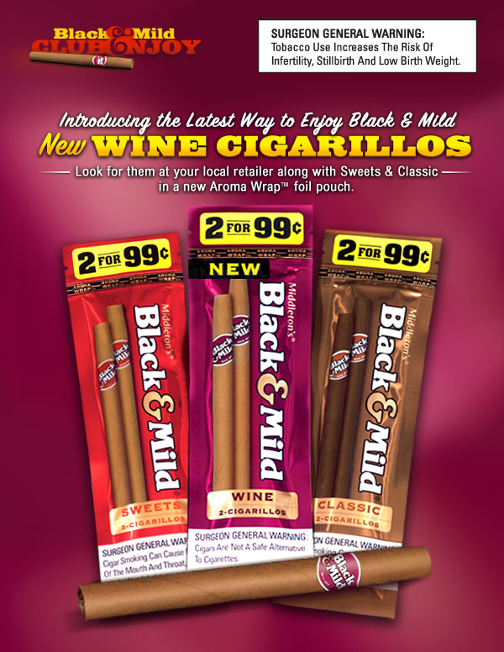
Notes:
For those of you who may be unfamiliar with these products, LCCs are combustible tobacco products that are inhaled like cigarettes and are similar to cigarettes in their size, shape, filtering, and tobacco pH.
Common brand names –BM, SS, White Owls, Phillies Blunts, etc.

Slide 5

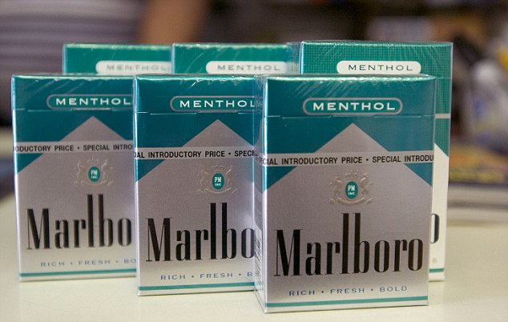
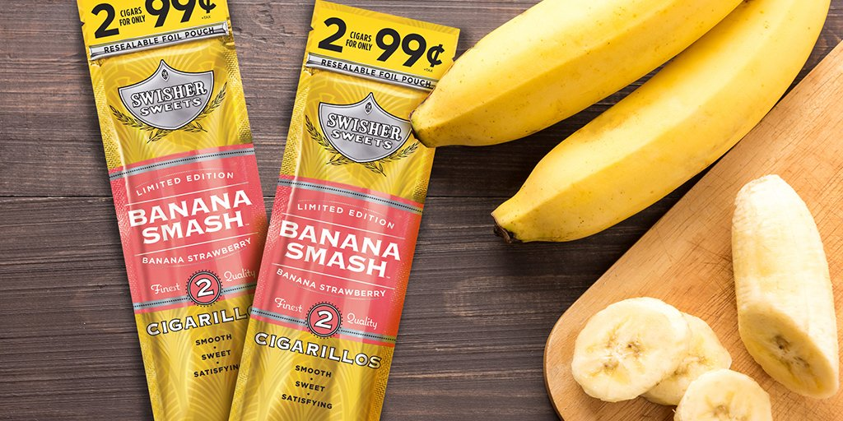
Little Filtered Cigars and Cigarillos (LCCs): Popular Combustible Tobacco Products
Cigarette Federal Regulations
-Advertising restrictions
-Pack size restrictions
-Menthol flavor (*)
LCC Federal Regulations
-No advertising restrictions
-No pack size restrictions
-Appealing flavors: fruit, candy, alcohol, menthol, chocolate, “concept” (*)
Notes:
Although little filtered cigars and cigarillos, which I will refer to as LCCs, are now “deemed” under the FDA’s authority, these products have fewer regulations imposed by FDA than cigarettes
For instance, cigarettes have minimum pack size requirements and advertising restrictions, whereas little filtered cigars and cigarillos do not.
Both products have flavored varieties. Currently, some cigarettes are mentholated. Little filtered cigars and cigarillos are available in variety of flavors.
FDA has announced that it plans to propose tobacco product standards to ban menthol as a characterizing flavor in cigarettes and ban all flavors (including menthol) in cigars.
But these flavors will remain on the market until these product standards are issued (*)

Slide 6

Little Filtered Cigars and Cigarillos (LCCs): Popular Combustible Tobacco Products
Popularity of LCC has grown among young adults¹⁻²
African-Americans, Hispanics, cigarette smokers at heightened risk
Some young adults believe LCCs are safer to use than cigarettes³⁻⁴
May promote initiation among non-tobacco users and prolong smoking maintenance among users
¹ Kasza et al., 2017, ²Delnevo et al., 2014, ³Richter et al., 2006, ⁴Jolly, 2008
Notes:
The popularity of little filtered cigar and cigarillo use has grown, particularly among young adults, males, non-Hispanic Blacks, Hispanics and those with tobacco product use experience (such as cigarette use).
Popularity of LCCs can be attributed to several factors, including the cigar industry’s marketing of appealing flavors, and the products’ affordability (e.g. often available for as little as $0.99) and accessibility of LCCs (e.g. sold as a single stick or two for the price of one), which make them attractive among price-sensitive young adults.
Additionally, marijuana is often co-administered in LCC products as blunts – or hollowed-out LCC products filled with marijuana. The ability to use LCCs as marijuana delivery devices may also be appealing to young adults.
there is evidence that young adults perceive LCCs in general, and flavored LCCs in particular, as less risky to smoke than other tobacco products
In sum, their “less” regulated status is concerning as it may promote initiation among non-tobacco users and smoking maintenance among users.

Slide 7
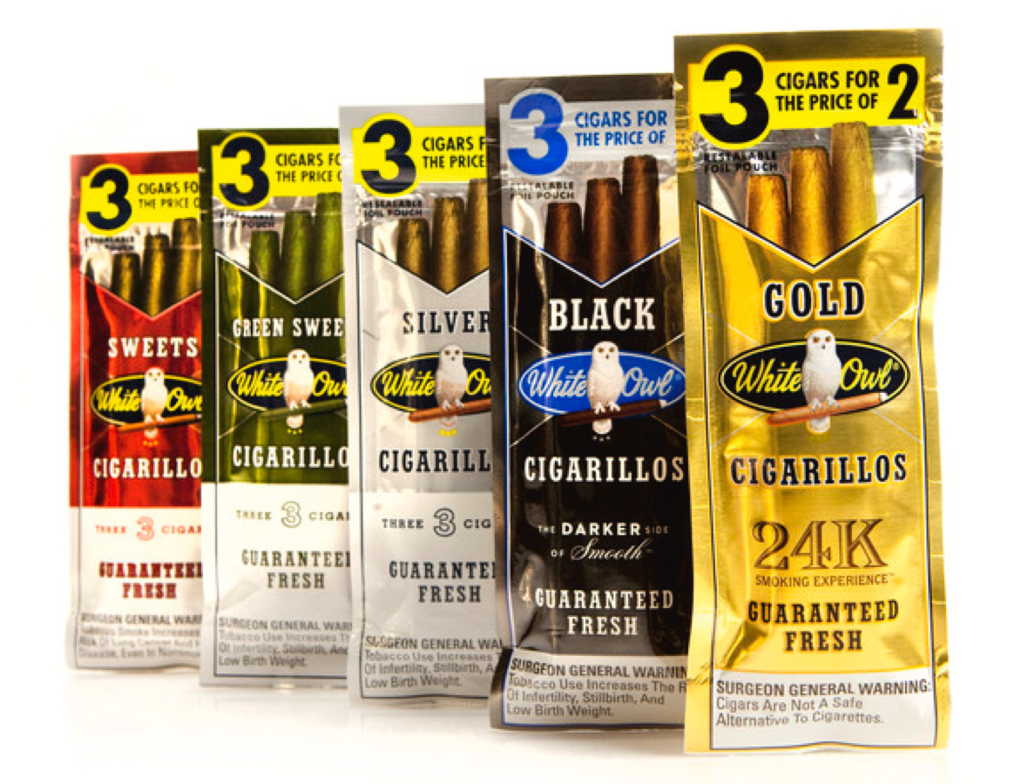
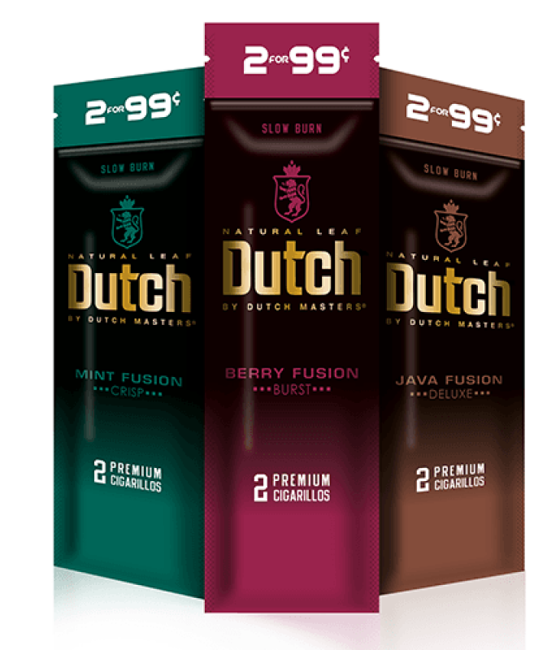
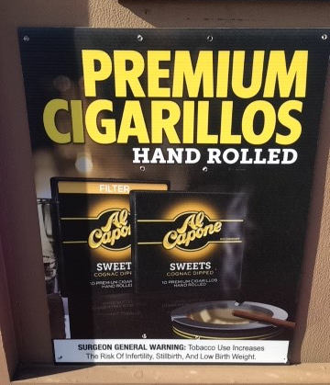
Product Packaging Appeal
Product packaging features may contribute to appeal and misperceptions about the harmfulness of use
Features include:
Product design (e.g. filters, small pack size)
Flavors and their depiction (e.g. colors, images, flavor descriptors)
Tobacco quality claims
Notes:
Let’s focus our attention on product packaging.
Features of product packaging may contribute to the appeal of little filtered cigars and cigarillos among young adults’, and may influence their misconceptions about LCC risk.
Research has pointed to industry use of package characteristics – e.g. product design (color, images, and flavor descriptors) and tobacco quality claims – to target and appeal to specific groups and manipulate consumers’ perceptions of the products’ harms.
Thus, product packaging should be an potentially important regulatory area for the FDA’s consideration.
May become even more important to monitor/assess if/when FDA issues the proposed product standards.

Slide 8
Research Priorities
What are the factors, including menthol and other flavorings, that influence the appeal of tobacco products (e.g. little cigars and cigarillos) to both users and non-users, including youth and other vulnerable populations?
How do factors related to packaging, labeling and advertising of tobacco products (e.g. colors, descriptors, marketing claims, branding) influence consumer perceptions about the risks of tobacco products and product use?
Notes:
The findings that I’ll present today are from two research projects that were conducted to provide evidence to the CTP to address the priorities listed here on the screen
Both studies will provide evidence to the field about the appeal of flavors in LCCs and the appeal of its product packaging

Slide 9

Study 1: Discrete Choice Experiment to Assess Young Adult Preferences for Little Cigar and Cigarillo Use (1P50DA036128)

Slide 10
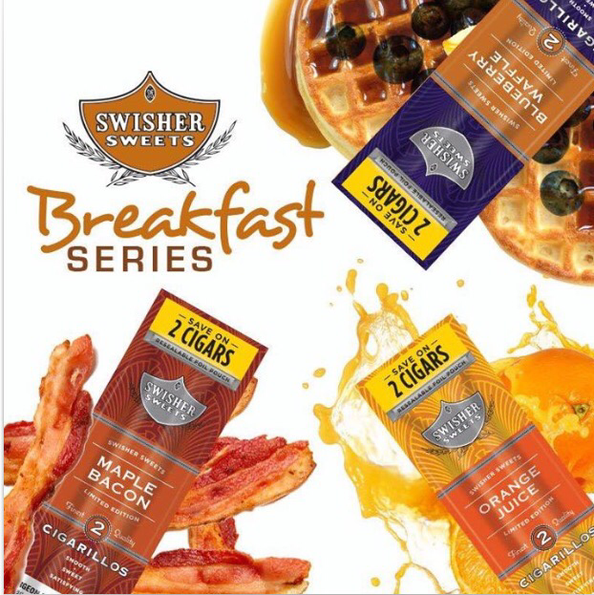
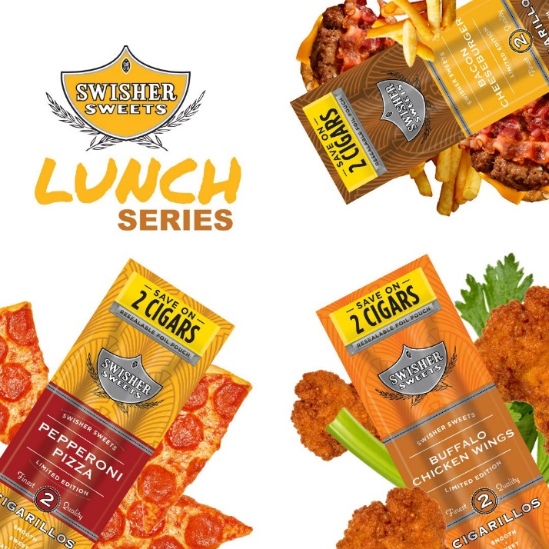
Research Question
What is the impact of flavored LCC package features on racially/ethnically diverse young adults’ preferences for LCCs?
Notes:
Qualitative research findings suggested the portrayal of flavor through package color, images, descriptors influenced appeal among our young adult smokers
From a regulatory perspective, it may be important to understand 1) whether flavored LCC packaging features (e.g. text, colors, pack size, price) influence young adults’ tobacco choices; and 2) which packaging feature(s) influence(s) product preference

Slide 11
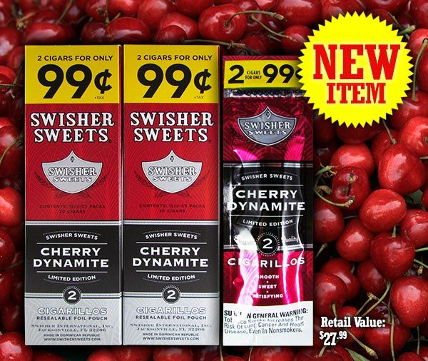
Discrete Choice Experiment (DCE) Study Design
Observational research shows actual preferences
DCE: respondents state their preference or choice of LCCs with hypothetical package features
Each package varied by:
Flavor
Flavor depiction
Text descriptor
Pack size
Price per cigarillo stick
Asked to choose an option: A, B, or opt-out
Notes:
Our qualitative findings provided us with our respondents actual preferences, based on 1) what they were exposed to and/or 2) what they choose
But exposure may be restricted by a lot of factors, like availability
To complement the FG research, we conducted a discrete choice experiment
Where respondents were exposed to hypothetical LCC packages, which included a priori selected package features that may be of interest to FDA (e.g. flavors, text descriptors)
The key advantage of this DCE framework is its ability to elicit participant responses to hypothetical flavored LCC packages with a priori features. Respondents make their choice in a controlled setting, that avoids limitations one would experience in the real world (e.g. lack of availability to the product)

Slide 12
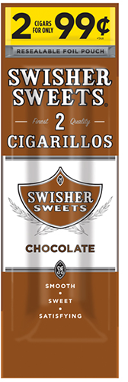
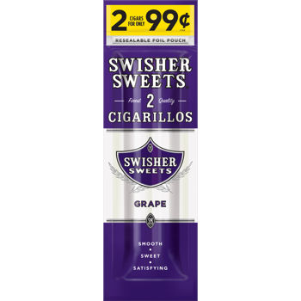

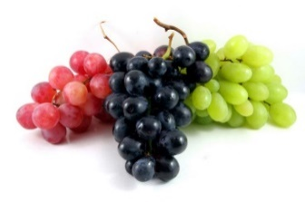
DCE Sample Choice Set
“Imagine you were shopping for a cigarillo. Which one would you choose?”
Brand: Swisher Sweets
Flavor: Chocolate (text & image)
Pack size: 2 cigarillos
Text descriptor: Mild
Price: $0.99
Brand: Swisher Sweets
Flavor: Grape flavor (image only)
Pack size: 2 cigarillos
Text descriptors: Natural
Price: $0.99
Neither of these
Option C
Option A
Option B
Notes:
Unlike lab-based experiments, DCEs use survey questions that elicit consumer preference, and are usually conducted as part of an online survey
This is an example of a DCE choice set, where respondents are shown images of hypothetical cigarillo packages that were varied with respect to flavor, flavor depiction (color, text, or both), descriptor of the LCC’s quality, pack size, and price.
After viewing the hypothetical packages, the respondents were asked to select their preferred product.

Slide 13
Recruitment & Study Procedures
Nationally representative sample of young adult cigarette smokers
Cigarette smokers, ever LCC users (n=270)
Cigarette smokers, non-LCC users (n=296)
Aged 18-34 years (mean=28 years)
Oversample for African-Americans and Hispanics
Screening/Pre-Experiment Survey
566 young adult cigarette smokers
270 cigarette, ever LCC users
296 cigarette, non-LCC users
Discrete Choice Experiment
Notes:
For our study, a convenience sample of 566 US young adult cigarette smokers aged 18-34, were recruited using Facebook ads.
Because young adult current cigarette smokers have elevated risks of LCC smoking , we aimed to obtain a sample of cigarettes smokers where half were current LCC users and half were not.

Slide 14
DCE Attribute & Levels
Package-Related Attribute | Attribute Levels
Flavors | Tobacco/regular Menthol Grape Alcohol
Flavor depiction | Text only Color only Color and Text
Text descriptors | Satisfying Smooth Sweet
Pack size | Single 2 per pack 3 per pack 4 per pack
Price per stick | $0.50, $1.00, $1.50
Notes:
We chose cigarillo packaging-related attributes that are of regulatory interest, including product flavor, flavor depiction, text quality descriptors, pack size, and price per stick.
The attributes and levels were selected based on our qualitative study findings and a review of relevant literature

Slide 15
Participant Demographics (N=566)
Variables | Mean, % | Std. Dev.
Demographics
Age (18-34) | 27.94 | 4.08
Female | 63% | 0.48
Hispanic | 19% | 0.39
White | 71% | 0.45
Black | 15% | 0.36
Other races
Income: Low < $25,000 | 35% | 0.48
Income: Middle $25,000-$49,999 | 30% | 0.46
Income: High $50,000 or more | 35% | 0.48
Tobacco use
Ever used LCC | 75% | 0.43
Current use of LCC | 53% | 0.50
Notes:
This table shows the sociodemographic characteristics and tobacco use status and history of our study sample (N=566).
Participants were on average 28 years of age, and the majority were female, non-Hispanic, and White.
Notably, 75% of our sample had ever smoked LCCs, even one or two puffs; and over half reported currently using LCCs.

Slide 16
DCE Sample Choice Set
“Imagine you were shopping for a cigarillo. Which one would you choose?”
Brand: Swisher Sweets
Flavor: Chocolate (text & image)
Pack size: 2 cigarillos
Text descriptor: Mild
Price: $0.99
Brand: Swisher Sweets
Flavor: Grape flavor (image only)
Pack size: 2 cigarillos
Text descriptors: Natural
Price: $0.99
Neither of these
Option C
Option A
Option B
Notes:
Again, recall that respondents are shown images of hypothetical cigarillo packages that were varied with respect to product attributes and levels shown previously
After viewing the hypothetical packages, the respondents were asked to select their preferred product.

Slide 17
Results
 | MNL β(se) | NL β(se) | RPL β(se) |  | RPL SD(se)
Descriptor
Smooth (base)
Satisfying | -0.1*** (0.03) | -0.06*** (0.02) | -0.1*** (0.04) |  | 0.07 (0.03)
Sweet | 0.087* (0.05) | 0.036 (0.03) | 0.1** (0.05) |  | 0.43 (0.6)
Flavor Descriptor
Text only (base)
Color only | 0.21*** (0.05) | 0.11*** (0.03) | 0.23*** (0.04) |  | 0.01 (0.08)
Color and Text | 0.29*** (0.05) | 0.16*** (0.04) | 0.3*** (0.05) |  | 0.1 (0.12)
Flavors
Grape (base)
Menthol | -0.21*** (0.08) | -0.12*** (0.03) | -0.25*** (0.06) | 0.76** (0.35) | 0.76** (0.35)
Regular | -0.25*** (0.08) | -0.14*** (0.04) | -0.28*** (0.05) | 0.01 (0.05) | 0.01 (0.05)
Alcohol | -0.25***(0.07) | -0.15***(0.04) | -0.27***(0.06) | 0.16(0.21) | 0.16(0.21)
Notes:
To analyze our data, we used mixed (random parameter) logit regressions to jointly analyze the effects of package attributes on the choice of LCCs, after controlling for individual-level sociodemographic characteristics (sex, age, race/ethnicity, income) and current LCC use status (yes or no).
Standard errors were clustered at the individual level, since the analytical data contained repeated choices made by the same individual.
Remember our outcome here is product preference
Our data suggested that young adults preferred grape flavor over menthol, tobacco/regular, and sweet flavors; “color only” and “color and text” flavor depictions over a text only depiction; “smooth” and “sweet” LCC quality descriptors over “satisfying”;
The results are consistent across the three different regression models.

Slide 18
Results (cont.)
 | MNL β(se) | NL β(se) | RPL β(se) | RPL SD(se)
Pack size | 0.05*(0.03) | 0.03***(0.01) | 0.06*(0.02) | 0.27***(0.09)
Price | -1.41*** (0.13) | -0.78*** (0.15) | -1.55*** (0.10) | 0.05 (0.07)
IV (lcc) | -- | 0.53***(0.1)
SD (lcc) | -- | 2.45***(0.48)
Log Likelihood | -5788 | -5778 | -5785
AIC | 11614 | 11597 | 11628
Notes:
Additionally, our findings suggested that young adults preferred bigger pack sizes and lower prices.
Again, The results are consistent across the three different regression models.

Slide 19
Study 1 Conclusions
Young adult smokers preferred
Grape flavor
Color only and color + text presentation
“Smooth” and “sweet” descriptors
Bigger pack sizes
Lower prices
Heterogeneity in menthol flavor preference and pack sizes
Notes:
In summary, young adult cigarette smokers preferred
grape flavors in LCCs;
prefered “color only” and “color and text” flavor depictions;
prefer “smooth” and “sweet” quality descriptors; and
and bigger pack sizes and lower prices.
We discovered important heterogeneities in young adult cigarette smokers’ preferences for LCC pack sizes and flavors.
Specifically, our findings suggest that, although on average our sample preferred grape over menthol flavors, some did prefer menthol over other flavors
In addition, there was heterogeneity in our sample’s preference for pack size, with some preferring smaller pack sizes to larger pack sizes

